Slide 1
Capture and Analysis of Twitter Data
CUS680 - Big Data 1
Sen Varghese, Zachary Kelly, Eric Alvarado
May 8, 2018

Slide 2
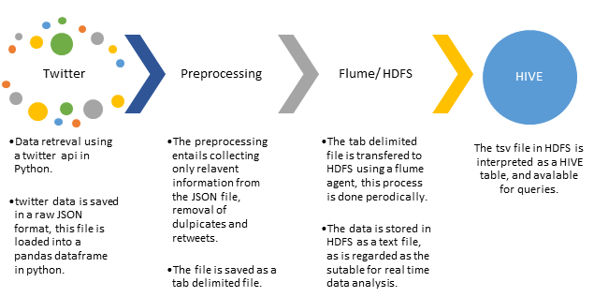
Map

Slide 3


Data Capture
Python
Tweepy Library
Pandas
Read from Twitter via API
Write to JSON

Slide 4

Preprocessing
Read from JSON specific columns
Remove RTs using Pandas
Keep all
Write to TSV
Write to TSV

Slide 5
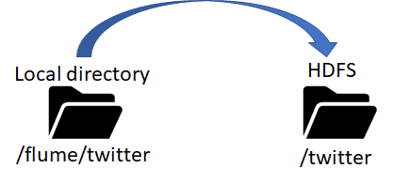
Flume
twitter.source = local_dir
twitter.sink = hdfs_sink
twitter.channels = mem_channel

Slide 6
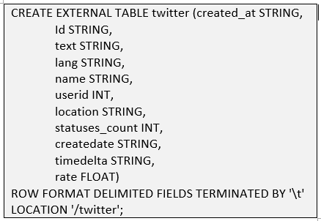

HIVE
The Flume agent is then manually shut off so the data can be preprocessed and shoved into Hive.
From here the data can be queried on, and information can be disseminated.

Slide 7
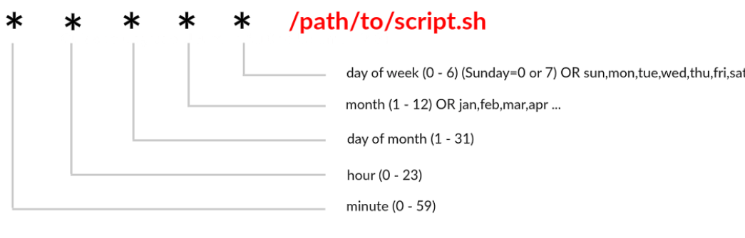
Job Processing
Leverage CRONTAB to run Python Script at :00 and :30
Leverage CRONTAB to run Flume for transport at :15 and :45
Leverage CRONTAB at the end of day clean *-COMPLETED
Hive is configured to import data loaded into HDFS at the designated spot as an external table

Slide 8
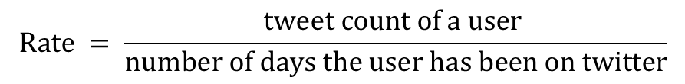
Data Analysis
Leverage MapReduce to determine to following items:
Word Frequency
Bigram Frequency
Most active user
$$Rate = \frac{tweet count of a user }{number of days the user has been on twitter}$$

